Slide 1
Graph Theory-tree
Dr Honey Sharma
GGI, Ludhiana
Reference Book: Kenneth H. Rosen, Discrete Mathematics and its Applications, 7th ed, McGraw Hill

Slide 2
Tree
A tree is a connected undirected graph with no simple circuits.
Forest : A collection of Tree
Leaf : A vertex of degree 1
Branch node or Internal node: A vertex of degree more than 1

Slide 3
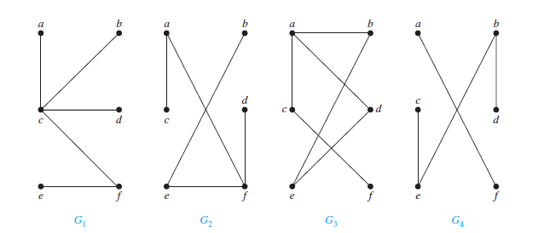
Tree
Which of following graphs are tree?
Yes Yes No No

Slide 4
Theorem: An undirected graph is a tree if and only if there is a unique simple path between any two of its vertices.
Proof: First assume that T is a tree. Then by definition T is a connected graph with no simple circuits. Let x and y be two vertices of T . As T is connected, therefore T has a simple path between x and y. Now, we need to prove the uniqueness of the path only. Let if possible there is a second such path, the path formed by combining the first path from x to y followed by the path from y to x obtained by reversing the order of the second path from x to y would form a circuit. Therefore, T cannot be a Tree, which is a contradiction. Hence, there is a unique simple path between any two vertices of a tree.

Slide 5
Now assume that there is a unique simple path between any two vertices of a graph T. Then by definition of connected graph, T is connected. Now its need to prove that T can have no simple circuits. To prove, lets suppose T had a simple circuit that contained the vertices x and y. Then there would be two simple paths between x and y, because the simple circuit is made up of a simple path from x to y and a second simple path from y to x. Hence, a graph with a unique simple path between any two vertices is a tree.

Slide 6
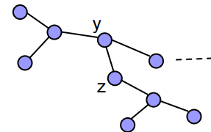
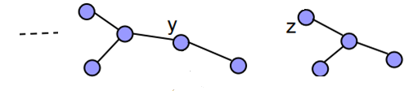
Theorem: In every tree T(V, E), |V| = |E| + 1.
Proof: We will prove the theorem by induction on number of edges.
Step I : |E|=1, only possible tree is
Therefore, |V| = |E| + 1 satisfied.
Step II: Assume that the theorem is true for trees of at most k edges.
Step III: Consider a tree T, where |E| = k + 1

Slide 7
By removing the edge (y,z), the tree T is divided in two subtrees T1(V1, E1) and T2(V2, E2) such that
|V| = |V1| + |V2| and |E| = |E1| + |E2| + 1.
Since 0 ≤ |E1| ≤ k and 0 ≤ |E2| ≤ k, t,herefore T1 and T2 satisfies the result. Hence,
|V1| = |E1| + 1 and |V2| = |E2| + 1.
Consequently,
|V| = |V1| + |V2|
= |E1| + 1 + |E2| + 1
= |E1| + |E2| + 1 + 1
= |E| + 1

Slide 8
Theorem: Any connected graph with n vertices and n−1 edges is a tree.
Proof: Let G be a connected graph with n vertices and n − 1 edges. To prove that G is a Tree, we have to show that G contains no cycles.
Assume to the contrary, lets suppose that G contains cycles.
Remove an edge from a cycle so that the resulting graph is again connected. Continue this process of removing one edge from one cycle at a time till the resulting graph H is a tree.
As H has n vertices, so number of edges in H is n−1.
The number of edges in G should greater than the number of edges in H( H is obtained by removing edges of G). So n−1 > n−1, which is not possible.
Hence, G has no cycles and therefore is a tree.

Slide 9
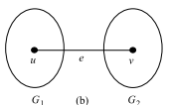
Theorem: A graph G with n vertices, n−1 edges and no cycles is connected.
Proof: Let G be a graph without cycles with n vertices and n−1 edges. We have to prove that G is connected.
Assume that G is disconnected. So G consists of two or more components and each component is also without cycles.
We assume without loss of generality that G has two components, say G1 and G2. Add an edge e between a vertex u in G1 and a vertex v in G2. Since there is no path between u and v in G, adding e did not create a cycle. Thus G ∪e is a connected graph (tree) of n vertices, having n edges and no cycles.
This contradicts the fact that a tree with n vertices has n−1 edges. Hence G is connected.

Slide 10
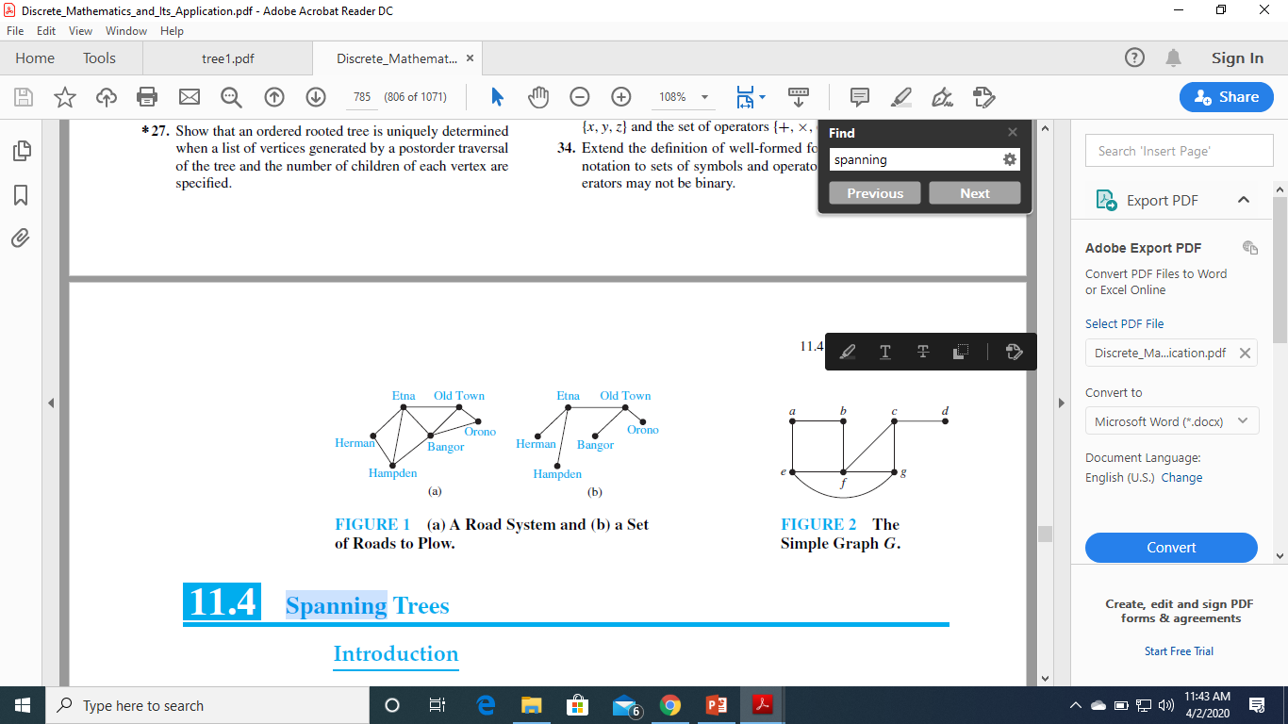
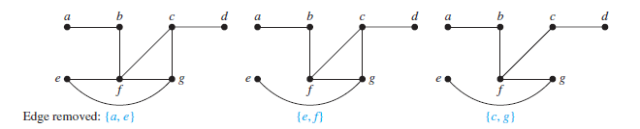
Spanning Tree
Let G be a simple graph. A spanning tree of G is a subgraph of G that is a tree containing every vertex of G.
Example:
The graph G is connected, but it is not a tree because it contains simple circuits.
Remove the edge {a, e}. This eliminates one simple circuit, and the resulting subgraph is still connected and still contains every vertex of G. Next remove the edge {e, f } to eliminate a second simple circuit. Finally, remove edge {c, g} to produce a simple graph with no simplecircuits. This subgraph is a spanning tree,

Slide 11
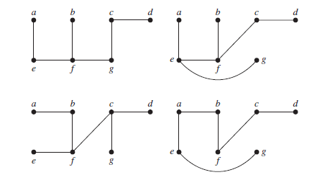
For instance, each of the above trees is a spanning tree of Given Graph.

Slide 12
Theorem: A simple graph is connected if and only if it has a spanning tree.
Proof: First, suppose that a simple graph G has a spanning tree T. T contains every vertex of G. Furthermore, there is a path in T between any two of its vertices. Because T is a subgraph of G, there is a path in G between any two of its vertices. Hence, G is connected.
Now suppose that G is connected. If G is not a tree, it must contain a simple circuit. Remove an edge from one of these simple circuits. The resulting subgraph has one fewer edge but still contains all the vertices of G and is connected. This subgraph is still connected because when two vertices are connected by a path containing the removed edge, they are connected by a path not containing this edge. If this subgraph is not a tree, it has a simple circuit; so as before, remove an edge that is in a simple circuit. Repeat this process until no simple circuits remain. This is possible because there are only a finite number of edges in the graph. The process terminates when no simple circuits remain. A tree is produced because the graph stays connected as edges are removed. This tree is a spanning tree because it contains every vertex of G.

Slide 13
Minimum Spanning Tree
A minimal spanning tree of a connected weighted graph G is a spanning tree whose total weight is minimum.
Kruskal’s Algorithm:
Sort all the edges in increasing order of their weight.
Starting only with the vertices of G and proceeding sequentially, add each edge which doesn’t result in a cycle until n-1 edges added.
Exit

Slide 14
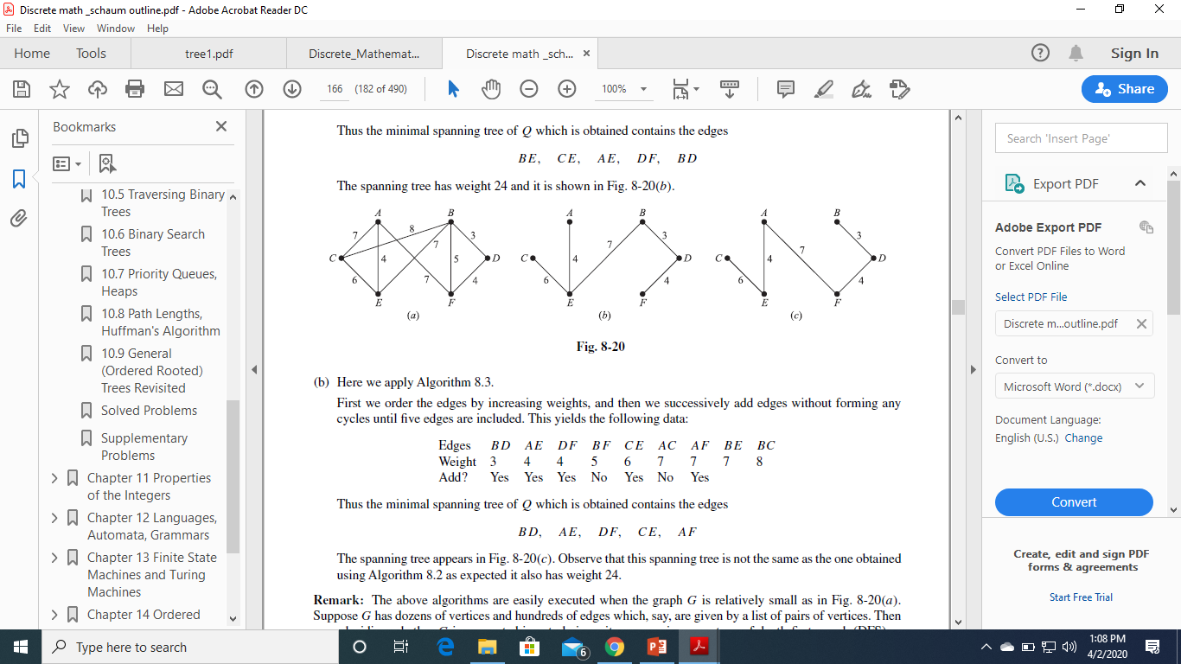
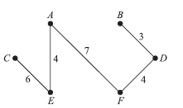
First we order the edges by increasing weights, and then we successively add edges without forming any cycles until five edges are included. This yields the following data:
Edges BD AE DF BF CE AC AF BE BC
Weight 3 4 4 5 6 7 7 7 8
Add? Yes Yes Yes No Yes No Yes
Thus the minimal spanning tree of Q which is obtained contains the edges BD, AE, DF, CE, AF, The spanning tree has weight 24

Slide 15
Prim’s Algorithm:
Sort all the edges in decreasing order of their weight.
Sequentially delete edge that doesn’t disconnect the graph until n-1 edges remains
Exit

Slide 16
First we order the edges by decreasing weights, and then we successively delete edges without disconnecting Q until five edges remain. This yields the following data:
Edges BC AF AC BE CE BF AE DF BD
Weight 8 7 7 7 6 5 4 4 3
Delete Yes Yes Yes No No Yes
Thus the minimal spanning tree of Q which is obtained contains the edges BE, CE, AE, DF, BD The spanning tree has weight 24

Slide 17
Rooted Trees
A rooted tree is a tree in which one vertex has been designated as the root and every edge is directed away from the root.
If v is a vertex in T other than the root, the parent of v is the unique vertex u such that there is an edge from u to v.
When u is the parent of v, v is called a child of u.
Vertices with the same parent are called siblings.
The ancestors of a vertex other than the root are the vertices in the path from the root to this vertex, excluding the vertex itself and including the root.
The descendants of a vertex v are those vertices that have v as an ancestor.
If a is a vertex in a tree, the subtree with a as its root is the subgraph of the tree consisting of a and its descendants and all edges incident to these descendants.

Slide 18
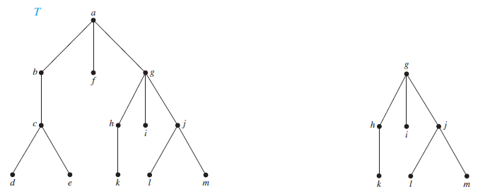
The subtree rooted at g
The parent of c is b.
The children of g are h, i, and j .
The siblings of h are i and j .
The ancestors of e are c, b, and a.
The descendants of b are c, d, and e.
The internal vertices
are a, b, c, g, h, and j .
The leaves are d, e, f , i, k, l, and m.

Slide 19
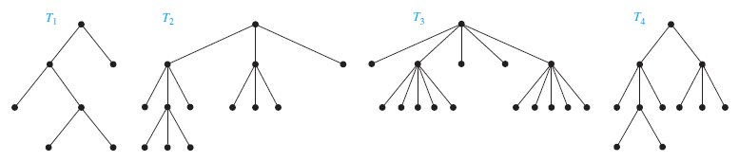
A rooted tree is called an m-ary tree if every internal vertex has no more than m children.
The tree is called a full m-ary tree if every internal vertex has exactly m children. An m-ary tree with m = 2 is called a binary tree.
T1 is binary tree.
T2 is full 3-ary tree
T3 is full 5-ary tree
T4 is not full ary tree

Slide 20
Theorem : Full m-ary tree with i internal vertices contains n = mi + 1 vertices.
Proof: Every vertex, except the root, is the child of an internal vertex. Because each of the i internal vertices has m children, there are mi vertices in the tree other than the root.
Therefore, the tree contains n = mi + 1 vertices.

Slide 21
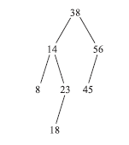
Binary Search Trees
Example : The binary tree T is a binary search tree. That is, every node N in T exceeds every number in its left subtree and is less than every number in its right subtree. Suppose the 23 were replaced by 35. Then T would still be a binary search tree. On the other hand, suppose the 23 were replaced by 40. Then T would not be a binary search tree, since 40 would be in the left subtree of 38 but 40 > 38.
Suppose T is a binary tree. Then T is called a binary search tree if each node N of T has the following property:
The value of N is greater than every value in the left subtree of N and is less than every value in the right subtree of N.
i.e. in which each node N has the following properties:
(a) N >M for every node M in a left subtree of N.
(b) N ≤ M for every node M in a right subtree of N.

Slide 22
Merge Sort
Divide the problem into a number of sub problems that are smaller instances of the same problem. Divide by finding the number of the position midway. Do this step the same way we found the midpoint in binary search.
Conquer the sub problems by solving them recursively. If they are small enough, solve the sub problems as base cases.
Combine the solutions to the sub problems into the solution for the original problem. Combine by merging the two sorted subarrays back into the single sorted subarray array

Slide 23
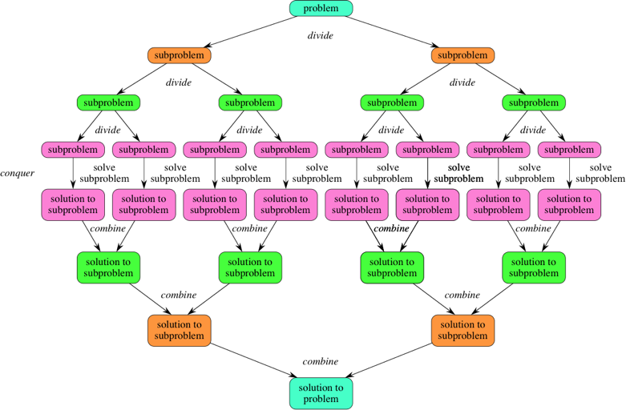

Slide 24
Split
Merge

Slide 25
WEIGHTED TREES AND PREFIX CODES
Consider the problem of using bit strings to encode the letters of the English alphabet (where no distinction is made between lower case and upper case letters).
We can represent each letter with a bit string of length five, since there are only 26 letters and there are 32 bit strings of length five. The total number of bits used to encode data is five times the number of characters in the text when each character is encoded with five bits.
Is it possible to find a coding scheme of these letters so that, when data are coded, fewer bits are used ? We can save memory and reduce transmittal time if this can be done.

Slide 26
WEIGHTED TREES AND PREFIX CODES
Consider using bit strings of different lengths to encode letters.
Letters that occur more frequently should be encoded using short bit strings, and longer bit strings should be used to encode rarely occurring letters.
When letters are encoded using varying numbers of bits, some method must be used to determine where the bits for each character start and end.
For instance, if e were encoded with 0, a with 1, and t with 01, then the bit string 0101 could correspond to eat, tea, eaea, or tt.

Slide 27
WEIGHTED TREES AND PREFIX CODES
One way to ensure that no bit string corresponds to more than one sequence of letters is to encode letters so that the bit string for a letter never occurs as the first part of the bit string for another letter. Codes with this property are called prefix codes.
For instance, the encoding of e as 0, a as 10, and t as 11 is a prefix code.
A word can be recovered from the unique bit string that encodes its letters. For example, the string 10110 is the encoding of ate. To see this, note that the initial 1 does not represent a character, but 10 does represent a (and could not be the first part of the bit string of another letter). Then, the next 1 does not represent a character but 11 does represent t. The final bit, 0, represents e.

Slide 28
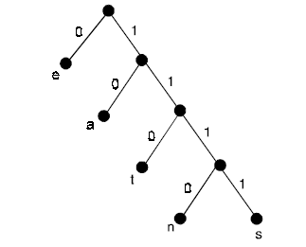
WEIGHTED TREES AND PREFIX CODES
A prefix code can be represented using a binary tree, where the characters are the labels of the leaves in the tree. The edges of the tree are labeled so that an edge leading to a left child is assigned a 0 and an edge leading to a right child is assigned a 1. The bit string used to encode a character is the sequence of labels of the edges in the unique path from the root to the leaf that has this character as its label.
For instance, the tree in represents the encoding of e by 0, a by 10, t by 110, n by 1110, and s by 1111.

Slide 29
The tree representing a code can be used to decode a bit string. For instance, consider the word encoded by 11111011100 using the code in the tree.
This bit string can be decoded by starting at the root, using the sequence of bits to form a path that stops when a leaf is reached. Each 0 bit takes the path down the edge leading to the left child of the last vertex in the path, and each 1 bit corresponds to the right child of this vertex.
Consequently, the initial 1111 corresponds to the path starting at the root, going right four times, leading to a leaf in the graph that has s as its label, since the string 1111 is the code for s.

Slide 30
Continuing with the fifth bit, we reach a leaf next after going right then left, when the vertex labeled with a, which is encoded by 10, is visited.
Starting with the seventh bit, we reach a leaf next after going right three times and then left, when the vertex labeled with n, which is encoded by 1110, is visited.
Finally, the last bit, 0, leads to the leaf that is labeled with e. Therefore, the original word is same.

